Slide 1
Appointments and Promotions
Lynn M Schnapp
Professor, Dept of Medicine
University of Washington
Thanks to Ginny Broudy, Brad Anawalt

Slide 2
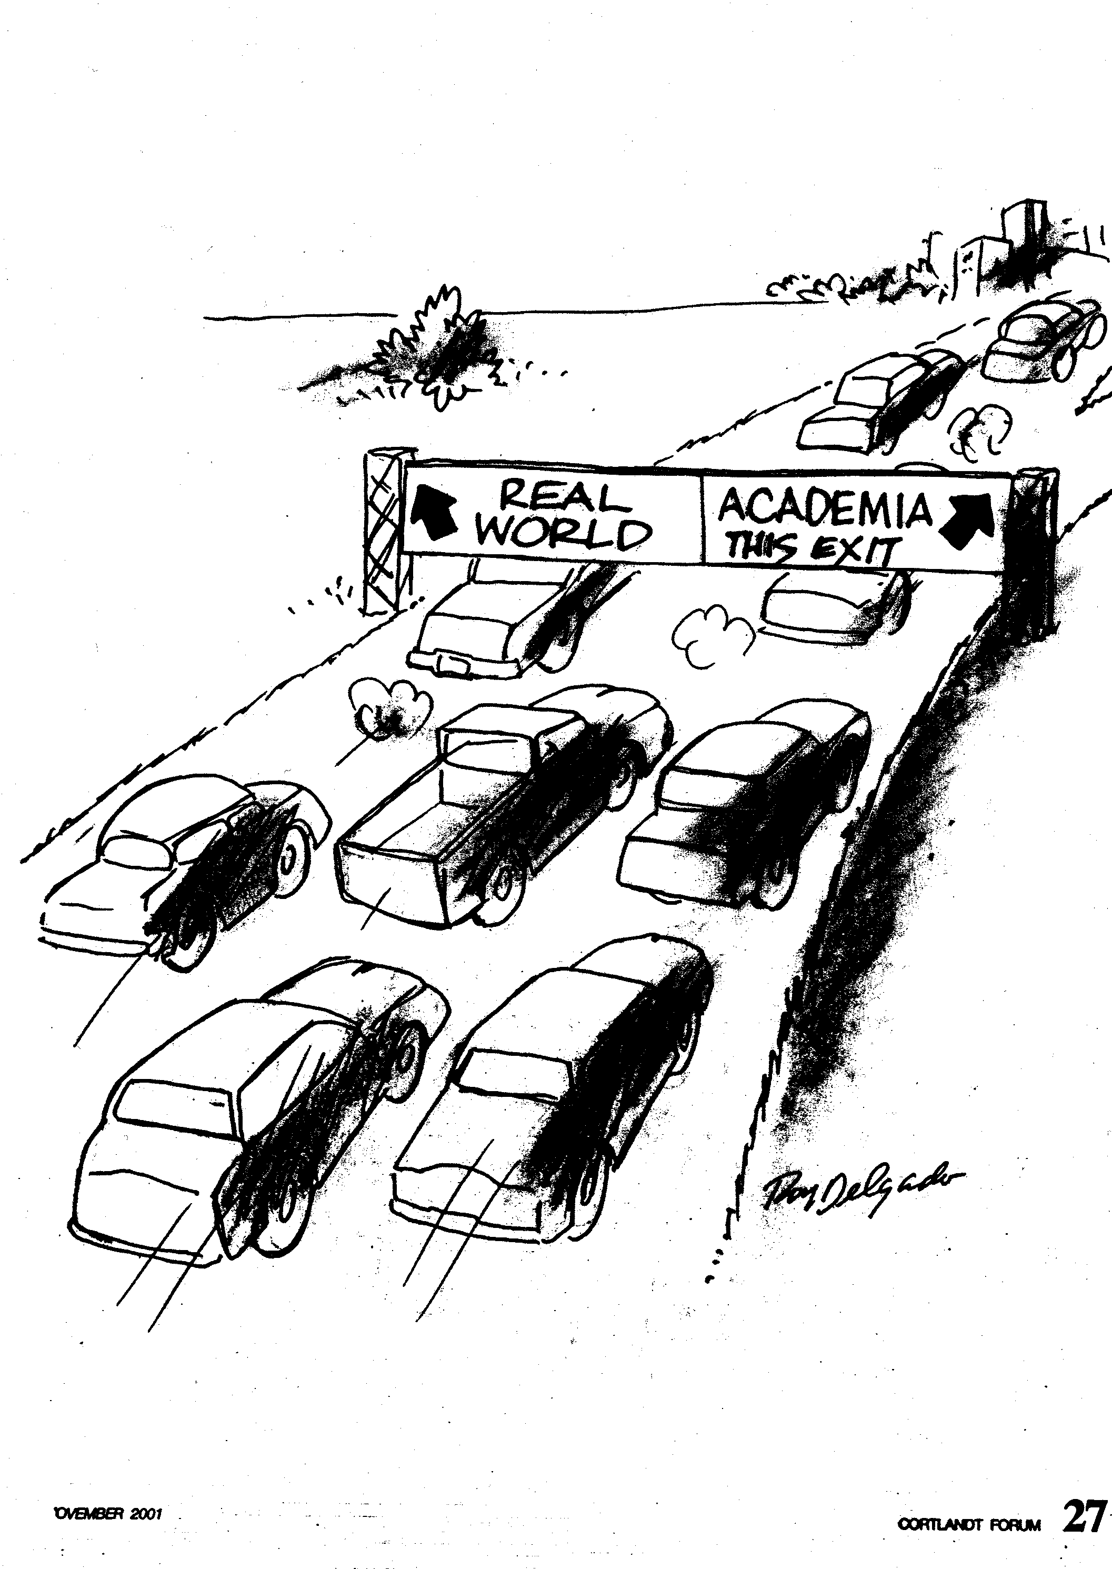

Slide 3
UW Faculty Pathways
Regular Faculty
Clinician-teacher
Physician-scientist
Research Faculty
Clinical Faculty
Pathways are University-Specific!

Slide 4
Physician-Scientist Pathway
Predominantly researcher & scholar
Outstanding research accomplishments
First and last-authored publications
Original, peer-reviewed research articles
Impact factor of journal
Grants
Mentorship
Clinical skills, leadership, citizenship, teaching, professionalism

Slide 5
Clinician-Teacher Pathway
“Predominantly” clinician & teacher
Outstanding clinical and teaching skills
Peer evaluations
Clinical benchmarks? 360° evaluations?
Scholarship:broad definition
Clinical skills, leadership, citizenship

Slide 6
Academic Ranks
Instructor
Assistant Professor
Associate Professor
Professor

Slide 7
Instructor
“Appointment to the rank of instructor requires completion of professional training and the promise of a successful career in teaching and research”
UW Faculty Handbook
Very rare appointment in Dept of Med
Most are appointed as Acting Instructor
(entry level faculty position)

Slide 8
“Acting” Appointments
One year appointments, renewed annually (no long-term commitment)
Maximum 4 years in a single rank (Acting Instructor or Acting Assistant Professor), and 6 years overall
No independent lab space
PI on grant proposals by permission

Slide 9
Acting Instructor
Board eligible/certified in specialty
Shows academic potential
Some scholarly achievement
Professionalism
Promotion clock does not start
“Buy time” for faculty with tenuous salary
Quick turnaround

Slide 10
Appointment to Acting Faculty
Division Head submits request to Chair
No search process
Begin appointment process
Division vote
Chair approval
Medical staff appointment
2-3 months

Slide 11
Asst Professor: qualifications
Requires a national search
Requires ≥ 3 years “solid” salary support
Strong scholarly record, clinical, teaching, professionalism
Usually minimum of 5 scholarly works
Quantity and quality matter
Different criteria for C-T & P-S paths

Slide 12
Appt to Asst Professor
Division Head submits request to Chair
Job description
Salary: requires source for 3 years minimum
Lab/work space
National search required
Search committee appointed by Chair
Advertisement
Interviews
Recommendation to Chair
6-12 month process

Slide 13
Asst Professor: Offer Letter
Offer letter from division head, chief of service and chair
NEGOTIATION
Acceptance letter
Appointment process begins
Vote by A & P committee
Vote by DoM faculty
Medical Staff appointment
3-6 months (12-18 months total)

Slide 14
Promotion takes time
Count Mean Min Max
Fellow to Acting Instructor 118 3.1 0 8.5
Fellow to Acting Asst Prof 41 4.6 0.9 7.7
Fellows to Asst Prof 80 5.4 2.2 9.0
Years to promotion

Slide 15
Assistant Professor
Two three-year appointments
“Up or Out” after 6 years
“Ask not for whom the clock ticks; it ticks for thee”
Most people get promoted
This is not a pyramid
The process is selective, but at the point of hire

Slide 16
Promotion to Associate Professor
Regional reputation for excellence
Physician-scientist pathway
Grants (R01 or equivalent)
Scholarship
~1-2 publications/year
Several 1st (or last) authored
C-T pathway
Regional reputation for clinical, teaching and/or leadership
Scholarship
~ 1 scholarly work/year

Slide 17
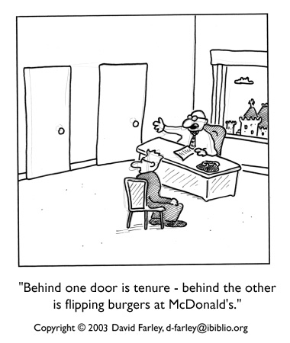
Promotion to Associate Professor
Promotion process usually starts in the spring of your 5th year as Assist Professor
Division Chief is in charge of your promotion to Assoc Professor

Slide 18
Promotion to Associate Professor
Vote of senior Division members
Package of CV, key scientific papers, teaching reviews, letters from internal and external reviewers and cover letter is sent to the Department A&P Committee in the fall of your 6th year, then to the Dean
You are promoted at the start of your 7th year
One year deferment is possible

Slide 19
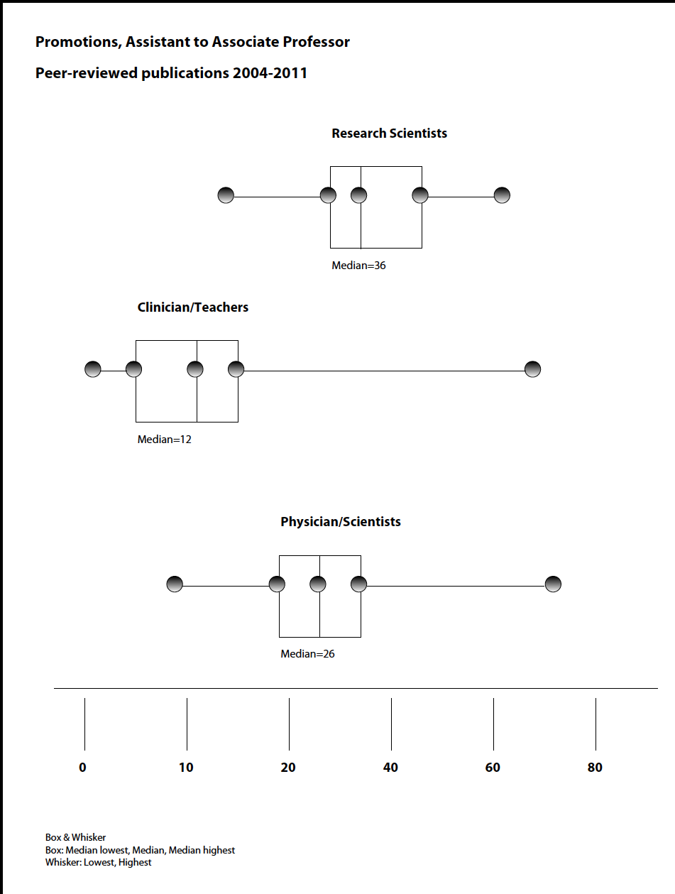

Slide 20
Promotion to Full Professor
National reputation for excellence
P-S pathway
Scientific independence
Grants, publications
National reputation as scientist, scientific leader
C-T pathway
National reputation for clinical, teaching and/or leadership
Scholarship

Slide 21
Case Study #1
Dr. Brad E Kardia is in his 3rd year of cardiology fellowship and is interested in pursuing academics as a clinician-teacher
CV: 3 publications; 1 first-authored; 5 abstracts
Excellent teaching evaluations
Excellent clinician
Good citizen
What faculty rank would he be eligible for?
What advice would you give Dr. Kardia to improve his chances for promotion?

Slide 22
Case Study #2
Dr. Al Veoli is in his 4th year of pulmonary fellowship and is interested in pursuing academics as a physician-scientist.
CV: 8 publications; 4 first-authored; 1 in JAMA (1st author)
Excellent teaching evaluations
Excellent clinician -- expertise in lung transplant
Good citizen
What faculty rank would he be eligible for?
What advice would you give to Dr. Veoli?

Slide 23
Case Study #3
Dr. Polly Rumatica is in her 2nd year of rheumatology fellowship and is interested in pursuing academics as a clinician-teacher.
CV: no publications; 1 abstract (research)
Excellent teaching evaluations
Excellent clinician
Good citizen
What advice would you give Dr. Rumatica to improve her chances for promotion?

Slide 24
Case Study #4
Dr. Din Ghee is in her 2nd year of ID fellowship and is interested in pursuing academics as a physician-scientist.
CV: 11 publications; 4 first (1 JCI) -- all from PhD
As a fellow: 1 abstract (research)
Do her publications as a PhD count for promotion?
What advice would you give Dr. Ghee to improve her chances for promotion?

Slide 25
Case Study #5
Dr. Earl E. Werk is in his 3rd year as Assistant Professor as a clinician-teacher. He spent 3 years as an acting instructor after completing a 4-year fellowship.
CV: 12 publications; none in the last 2 years
When would he be eligible for promotion to Associate Professor?
Why does he care?
What advice would you give Dr. Werk to improve his chances for promotion?

Slide 26
Case Study #6
Dr. Minnie Talence is in her 3rd year as Assistant Professor as a physician-scientist. She spent 3 years as an acting instructor after completing a 4-year fellowship.
CV: 12 publications; 5 original research (2 1st-authored), 3 review articles, 3 chapters, 1 website contribution
Funding: VA salary
When would she be eligible for promotion to Associate Professor?
What advice would you give to Dr. Talence?

